Slide 1
Model Validation Machine Learning
Data Science at Zindua School | By Chris Aloo

Slide 2
Model Validation

Slide 3
Model Validation
Model training, the wrong way
Hold-Out Sets
Cross Validation

Slide 4
What to do when our model is not performing well
Use a more complicated/more flexible model
Use a less complicated/less flexible model
Gather more training samples
Gather more data to add features to each sample
However, this is not always the answer as adding a more complicated model will give worse results, and adding more training samples may not improve your results
Knowing what to do, to improve your model performance is what will separate the novice from the pro Data Scientist.
Later we will also talk about error analysis, in detail, as a way to improve one’s model performance.

Slide 5
Bias Variance Tradeoff

Slide 6
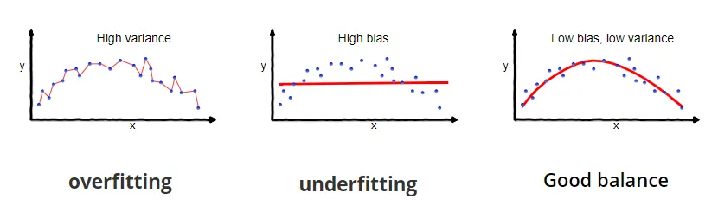
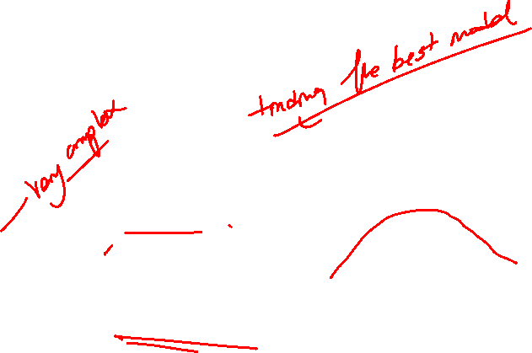
Overfitting and Underfitting
Notes:
In supervised learning, overfitting happens when our model captures the noise along with the underlying pattern in data. It happens when we train our model a lot over noisy dataset. These models have low bias and high variance. These models are very complex like Decision trees which are prone to overfitting.
In supervised learning, underfitting happens when a model unable to capture the underlying pattern of the data. These models usually have high bias and low variance. It happens when we have very less amount of data to build an accurate model or when we try to build a linear model with a nonlinear data. Also, these kind of models are very simple to capture the complex patterns in data like Linear and logistic regression.
As we add more and more parameters to our model, its complexity increases, which results in increasing variance and decreasing bias, i.e., overfitting.
By noise we mean the data points that don’t really represent the true properties of your data, but random chance

Slide 7
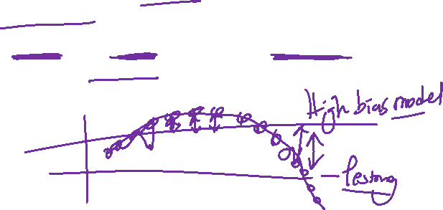
Defining Bias and Variance
What is bias? - Bias are the simplifying assumptions made by a model to make the target function easier to learn.
Model with high bias pays very little attention to the training data and oversimplifies the model. It always leads to high error on training and test data.
Notes:
In supervised machine learning an algorithm learns a model from training data.
The goal of any supervised machine learning algorithm is to best estimate the mapping function (f) for the output variable (Y) given the input data (X). The mapping function is often called the target function because it is the function that a given supervised machine learning algorithm aims to approximate.
Bias are the simplifying assumptions made by a model to make the target function easier to learn.
Generally, linear algorithms have a high bias making them fast to learn and easier to understand but generally less flexible.
In turn, they have lower predictive performance on complex problems that fail to meet the simplifying assumptions of the algorithms bias.
Low Bias: Suggests less assumptions about the form of the target function.
High-Bias: Suggests more assumptions about the form of the target function.
Examples of low-bias machine learning algorithms include: Decision Trees, k-Nearest Neighbors and Support Vector Machines.
Examples of high-bias machine learning algorithms include: Linear Regression, Linear Discriminant Analysis and Logistic Regression.

Slide 8
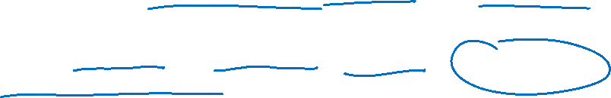
Defining Bias and Variance
What is variance? - Variance is the variability of model prediction for a given data point
Model with high variance pays a lot of attention to training data and does not generalize on the data which it hasn’t seen before
Notes:
Variance is the amount that the estimate of the target function will change if different training data was used.
Ideally, it should not change too much from one training dataset to the next, meaning that the algorithm is good at picking out the hidden underlying mapping between the inputs and the output variables.
Machine learning algorithms that have a high variance are strongly influenced by the specifics of the training data. This means that the specifics of the training have influences the number and types of parameters used to characterize the mapping function.
Low Variance: Suggests small changes to the estimate of the target function with changes to the training dataset.
High Variance: Suggests large changes to the estimate of the target function with changes to the training dataset.
Generally, nonlinear machine learning algorithms that have a lot of flexibility have a high variance. For example, decision trees have a high variance, that is even higher if the trees are not pruned before use.
Examples of low-variance machine learning algorithms include: Linear Regression, Linear Discriminant Analysis and Logistic Regression.
Examples of high-variance machine learning algorithms include: Decision Trees, k-Nearest Neighbors and Support Vector Machines.
Linear machine learning algorithms often have a high bias but a low variance.
Nonlinear machine learning algorithms often have a low bias but a high variance.

Slide 9
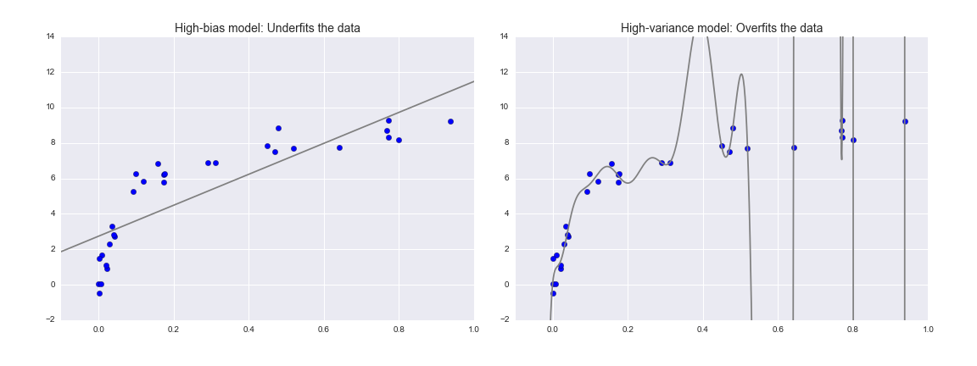
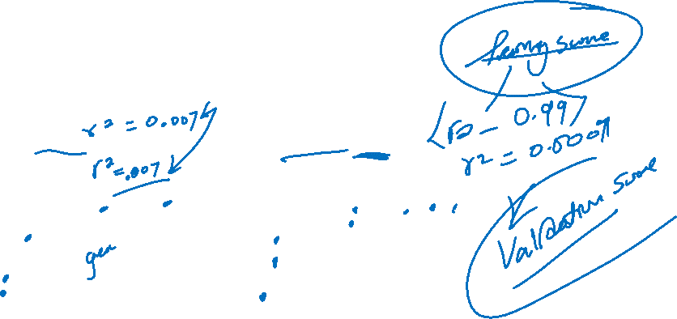
In Summary
Notes:
Variance is the amount that the estimate of the target function will change if different training data was used.
Ideally, it should not change too much from one training dataset to the next, meaning that the algorithm is good at picking out the hidden underlying mapping between the inputs and the output variables.
Machine learning algorithms that have a high variance are strongly influenced by the specifics of the training data. This means that the specifics of the training have influences the number and types of parameters used to characterize the mapping function.
Low Variance: Suggests small changes to the estimate of the target function with changes to the training dataset.
High Variance: Suggests large changes to the estimate of the target function with changes to the training dataset.
Generally, nonlinear machine learning algorithms that have a lot of flexibility have a high variance. For example, decision trees have a high variance, that is even higher if the trees are not pruned before use.
Examples of low-variance machine learning algorithms include: Linear Regression, Linear Discriminant Analysis and Logistic Regression.
Examples of high-variance machine learning algorithms include: Decision Trees, k-Nearest Neighbors and Support Vector Machines.
Linear machine learning algorithms often have a high bias but a low variance.
Nonlinear machine learning algorithms often have a low bias but a high variance.

Slide 10
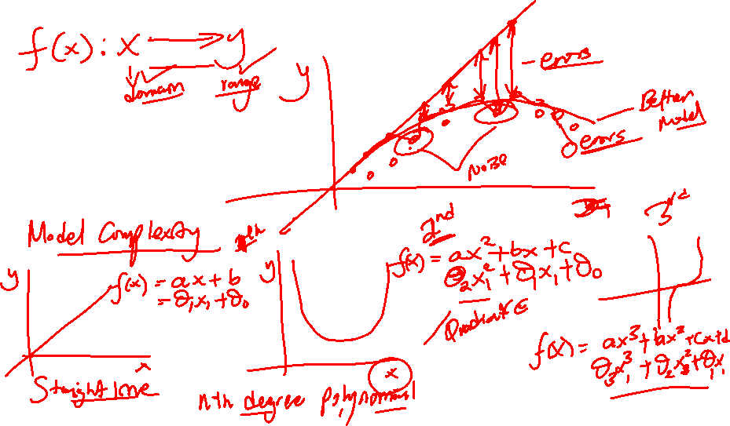
In Summary
Notes:
Variance is the amount that the estimate of the target function will change if different training data was used.
Ideally, it should not change too much from one training dataset to the next, meaning that the algorithm is good at picking out the hidden underlying mapping between the inputs and the output variables.
Machine learning algorithms that have a high variance are strongly influenced by the specifics of the training data. This means that the specifics of the training have influences the number and types of parameters used to characterize the mapping function.
Low Variance: Suggests small changes to the estimate of the target function with changes to the training dataset.
High Variance: Suggests large changes to the estimate of the target function with changes to the training dataset.
Generally, nonlinear machine learning algorithms that have a lot of flexibility have a high variance. For example, decision trees have a high variance, that is even higher if the trees are not pruned before use.
Examples of low-variance machine learning algorithms include: Linear Regression, Linear Discriminant Analysis and Logistic Regression.
Examples of high-variance machine learning algorithms include: Decision Trees, k-Nearest Neighbors and Support Vector Machines.
Linear machine learning algorithms often have a high bias but a low variance.
Nonlinear machine learning algorithms often have a low bias but a high variance.

Slide 11
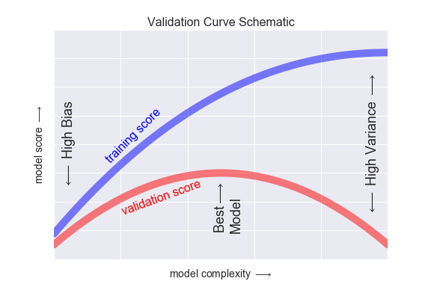
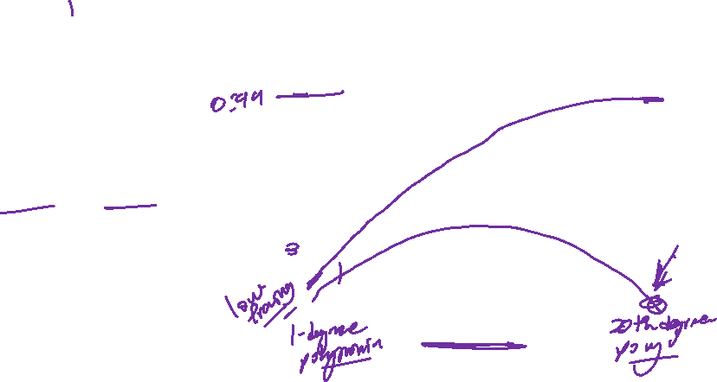
In Summary
The training score is always higher than the validation score.
Low Complexity – High Bias
High Complexity – High Variance
Notes:
Variance is the amount that the estimate of the target function will change if different training data was used.
Ideally, it should not change too much from one training dataset to the next, meaning that the algorithm is good at picking out the hidden underlying mapping between the inputs and the output variables.
Machine learning algorithms that have a high variance are strongly influenced by the specifics of the training data. This means that the specifics of the training have influences the number and types of parameters used to characterize the mapping function.
Low Variance: Suggests small changes to the estimate of the target function with changes to the training dataset.
High Variance: Suggests large changes to the estimate of the target function with changes to the training dataset.
Generally, nonlinear machine learning algorithms that have a lot of flexibility have a high variance. For example, decision trees have a high variance, that is even higher if the trees are not pruned before use.
Examples of low-variance machine learning algorithms include: Linear Regression, Linear Discriminant Analysis and Logistic Regression.
Examples of high-variance machine learning algorithms include: Decision Trees, k-Nearest Neighbors and Support Vector Machines.
Linear machine learning algorithms often have a high bias but a low variance.
Nonlinear machine learning algorithms often have a low bias but a high variance.

Slide 12
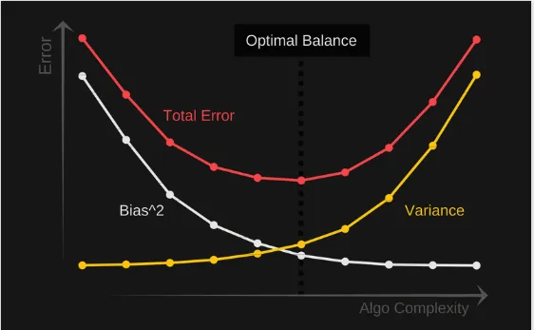
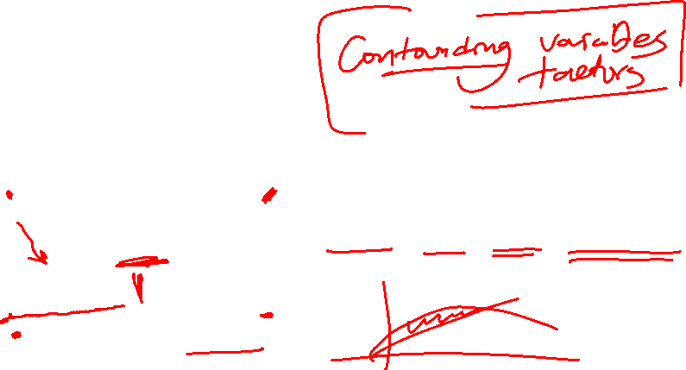
Error in Machine Learning
Notes:
Why is Bias Variance Tradeoff?
If our model is too simple and has very few parameters then it may have high bias and low variance. On the other hand if our model has large number of parameters then it’s going to have high variance and low bias. So we need to find the right/good balance without overfitting and underfitting the data.
The parameterization of machine learning algorithms is often a battle to balance out bias and variance.
Below are two examples of configuring the bias-variance trade-off for specific algorithms:
The k-nearest neighbors algorithm has low bias and high variance, but the trade-off can be changed by increasing the value of k which increases the number of neighbors that contribute t the prediction and in turn increases the bias of the model.
The support vector machine algorithm has low bias and high variance, but the trade-off can be changed by increasing the C parameter that influences the number of violations of the margin allowed in the training data which increases the bias but decreases the variance.

Slide 13
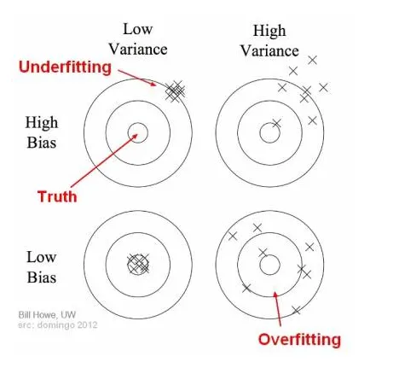
Bias and variance using bulls-eye diagram

Slide 14
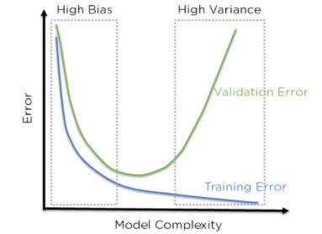
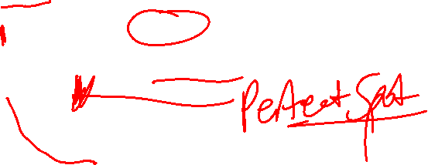
Another Way of thinking about it.
Notes:
A Bias occurs when an algorithm has limited flexibility to learn from data. Such models pay very little attention to the training data and oversimplify the model therefore the validation error or prediction error and training error follow similar trends. Such models always lead to a high error on training and test data. High Bias causes underfitting in our model.
Variance defines the algorithm’s sensitivity to specific sets of data. A model with a high variance pays a lot of attention to training data and does not generalize therefore the validation error or prediction error are far apart from each other. Such models usually perform very well on training data but have high error rates on test data. High Variance causes overfitting in our model.
As we add more and more parameters to our model, its complexity increases, which results in increasing variance and decreasing bias, i.e., overfitting. So we need to find out one optimum point in our model where the decrease in bias is equal to increase in variance. In practice, there is no analytical way to find this point. So how to deal with high variance or high bias?
To overcome underfitting or high bias, we can basically add new parameters to our model so that the model complexity increases, and thus reducing high bias.Now, how can we overcome Overfitting for a regression model?
Basically there are two methods to overcome overfitting,
Reduce the model complexity
Regularization
Here we would be discussing about Regularization in detail and how to use it to make your model more generalized.

Slide 15
Validation Curves in Machine Learning

Slide 16
Thank You

